Slide 1

Cardiovascular Health Assessment and Risk Prediction Model
Presented by –
Indrajith S.

Slide 2
Table of Content:
Problem Explanation
Data Preparation and Cleaning
Exploratory Data Analysis
Other Observation and Feature Selection
Model Training
Summary and Conclusion
Data Description

Slide 3
Problem Statement:
Cardiovascular diseases (CVDs) are the major cause of mortality worldwide.
The dataset is from an ongoing cardiovascular study on residents of the town of Framingham, Massachusetts. The classification goal is to predict whether the patient has a 10-year risk of future coronary heart disease (CHD). The dataset provides the patients’ information. It include over 3390 records and 16 attributes Variables. Each attribute is a potential risk factor. . In this project, we will be working on predicting the 10-year risk of Coronary Heart Disease (CHD). We are given a set of variables that impact heart diseases. These variables are related to demographic, past, and current medical history.

Slide 4
Data Description
There are a total of 16 feature columns where 'TenYearCHD' is the dependent variable column. The total number of observations(rows) are 3390.
Demographic:
Sex: male or female ("M" or "F")
Age: Age of the patient (Continuous - Although the recorded ages have been truncated to whole numbers, the concept of age is continuous)
Education: The level of education of the patient (categorical values - 1,2,3,4)
Behavioral:
is_smoking: whether or not the patient is a current smoker ("YES" or "NO")
Cigs Per Day: the number of cigarettes that the person smoked on average in one day.(can be considered continuous as one can have any number of cigarettes, even half a cigarette.)

Slide 5
Data Description
Medical (history):
BP Meds: whether or not the patient was on blood pressure medication (Nominal)
Prevalent Stroke: whether or not the patient had previously had a stroke (Nominal)
Prevalent Hyp: whether or not the patient was hypertensive (Nominal)
Diabetes: whether or not the patient had diabetes (Nominal)
Medical (current):
Tot Chol: total cholesterol level (Continuous)
Sys BP: systolic blood pressure (Continuous)
Dia BP: diastolic blood pressure (Continuous)
BMI: Body Mass Index (Continuous)
Heart Rate: heart rate (Continuous - In medical research, variables such as heart rate though in fact discrete, yet are considered continuous because of large number of possible values.)
Glucose: glucose level (Continuous)
Predict variable (desired target):
TenYearCHD: 10-year risk of coronary heart disease CHD(binary: “1”, means “Yes”, “0” means “No”)

Slide 6
Data Preparation & Cleaning
There are no duplicate rows in the dataset.
Changed the names for some columns for better understanding, and also splitted into categorical and continuous variables for easy visualization.
There are missing values in the columns education, cigs per day, BP meds, totChol, BMI, heart rate and glucose.
Totally 510 values are missing, As our dataset is Small, We can’t simply drop these values, So I had checked mode,mean and median values for these 7 columns.
Imputed the values by approriate suitable methods.

Slide 7
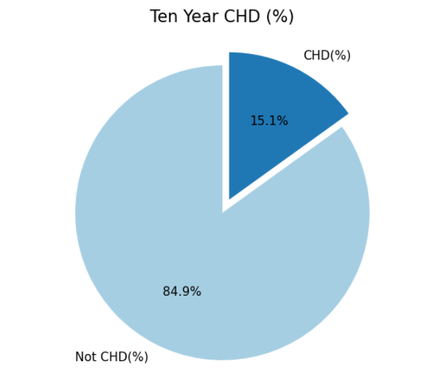
Exploratory Data Analysis:
While visualizing the Target variable, we can clearly see that our data is highly imbalanced.
Only 15.1% that is 511 out of 3390 are classified as positive for 10 year CHD whereas the remaining 84.9% that is 2879 out of 3390 are classified as negative for 10 year CHD.

Slide 8
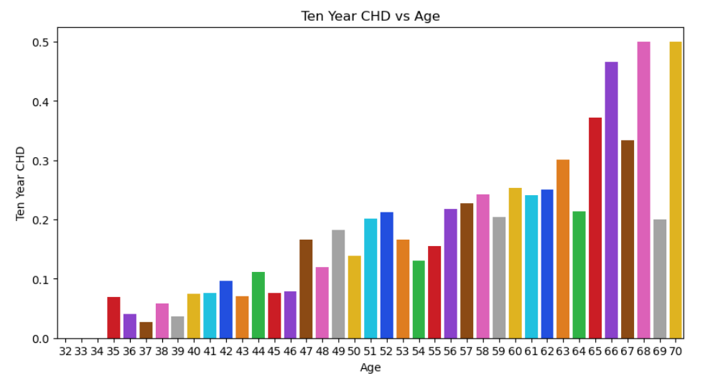
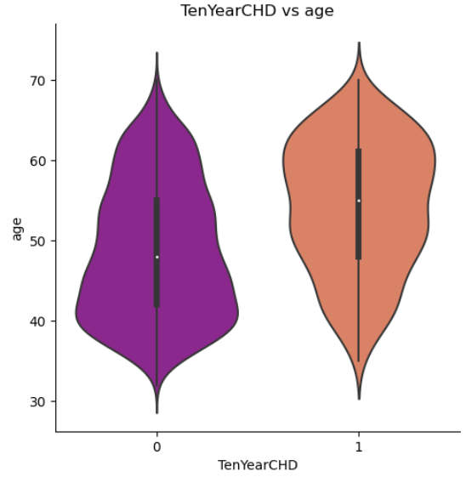
Ten Year CHD by Age
CHD probability is high for above 65+ aged peoples.
So, older people have a higher risk of having coronary heart disease in next 10 years.

Slide 9
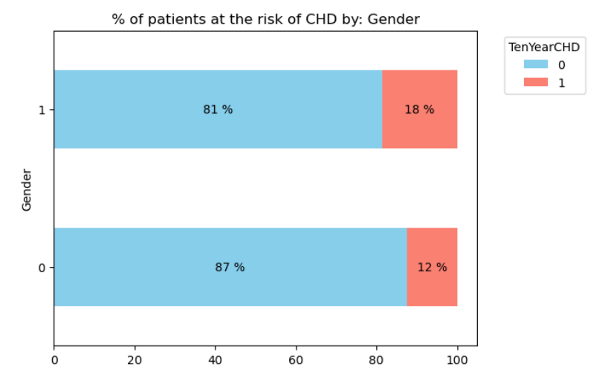
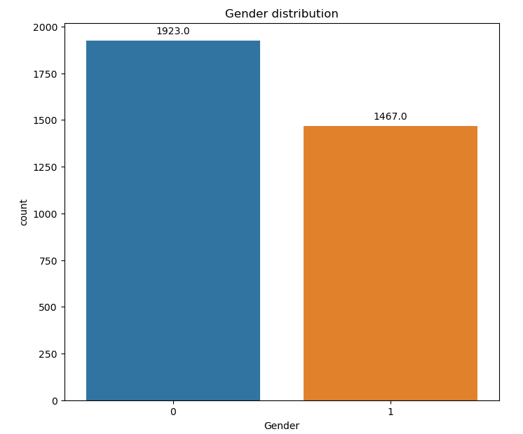
Ten Year CHD by Gender
The gender distribution is not even with high count for females. 53.2% are there for males and 46.8% for females.
Men are generally at a higher risk of having coronary heart disease.

Slide 10
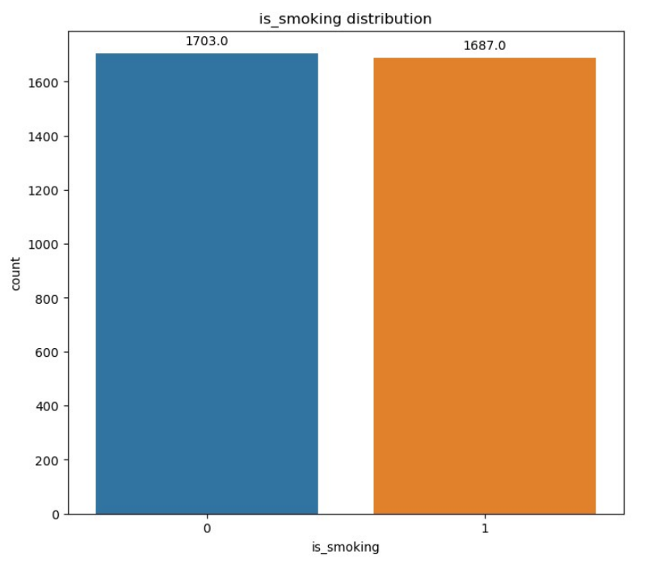
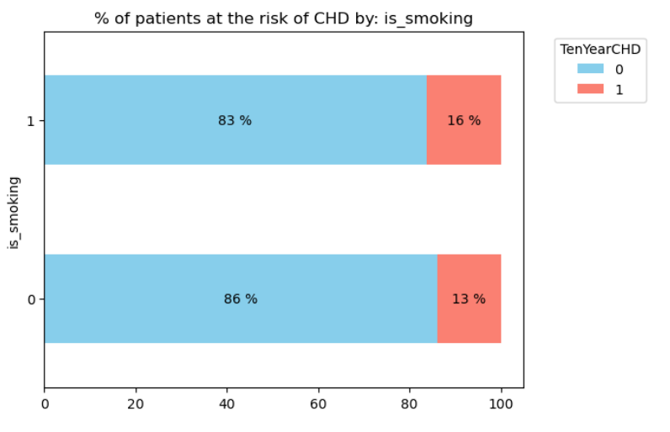
Ten Year CHD by Smoking
The negative cases are more for the non smokers compared to the positive cases for non smokers.
There is a possibility of having chd in next ten years for peoples who are smoking.

Slide 11
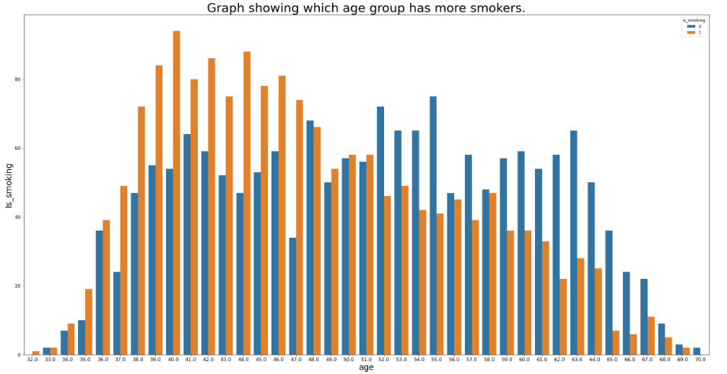
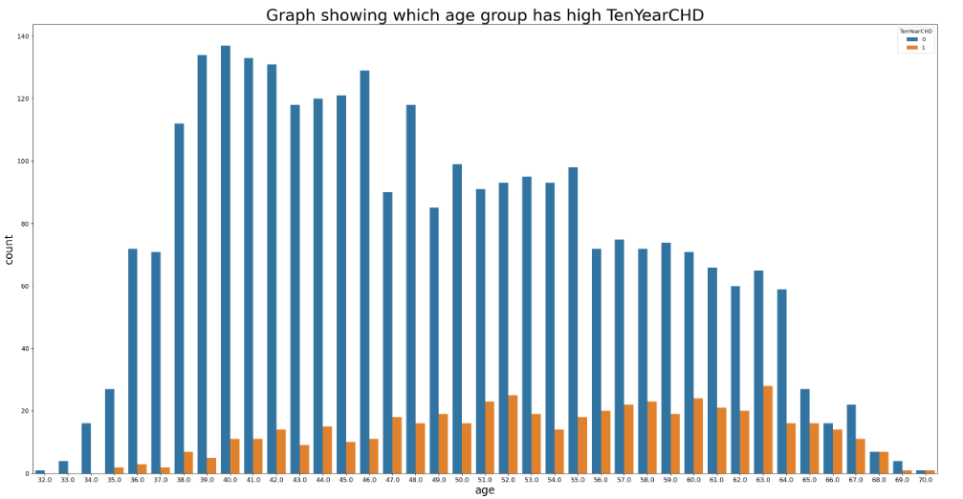
Age vs smoking and TenYearCHD:
Mid-age groups ranging from the age of 38 - 46 have more number of current Smokers and No Smokers observed below the age of 32 maximum age for a current Smokers is 70.
Persons who are Age 40 and smoking have high tendency of coronary heart disease in next 10 years.

Slide 12
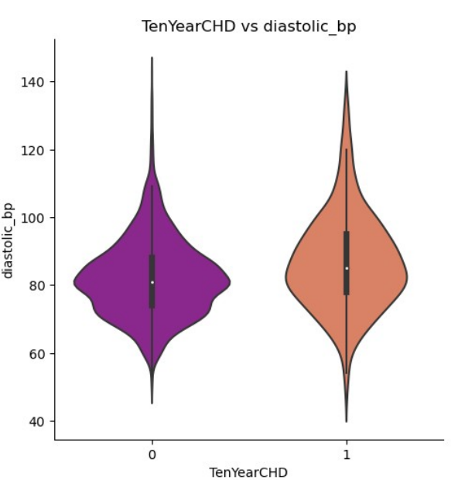
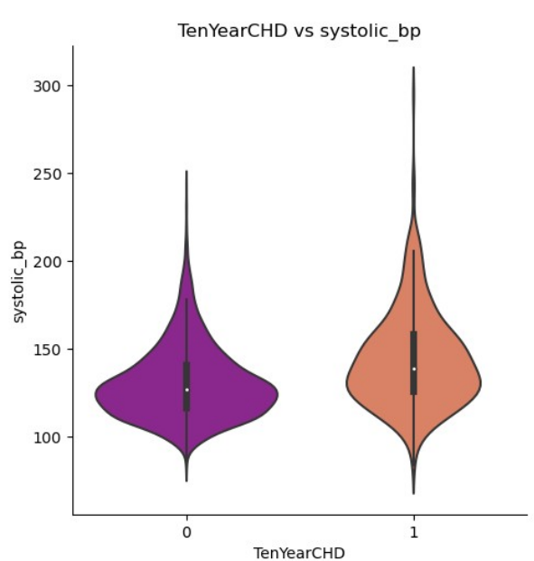
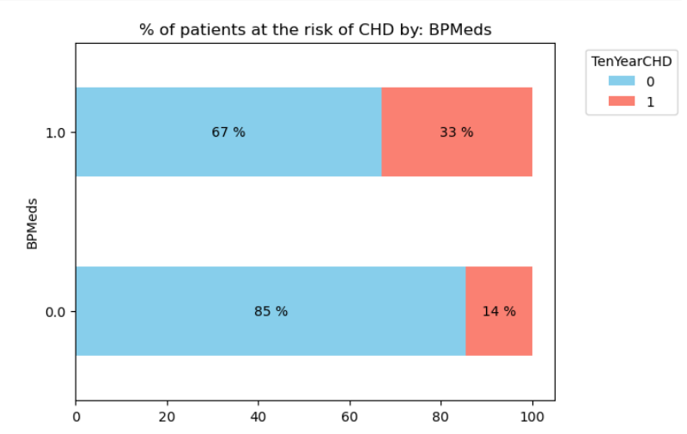
Relationship between Diastolic_bp,Systolic_bp and BpMeds:
Patients who have high blood pressure and have been taking BP medication have comparatively higher risk of CHD.

Slide 13
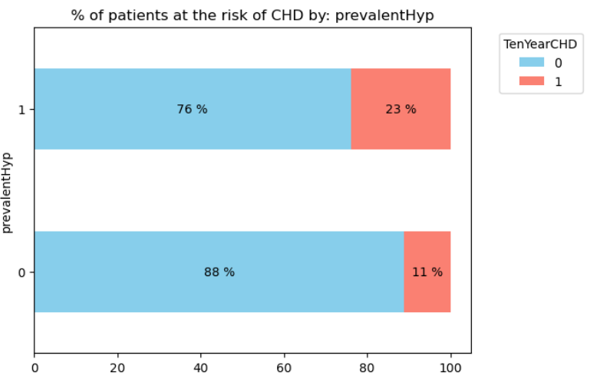
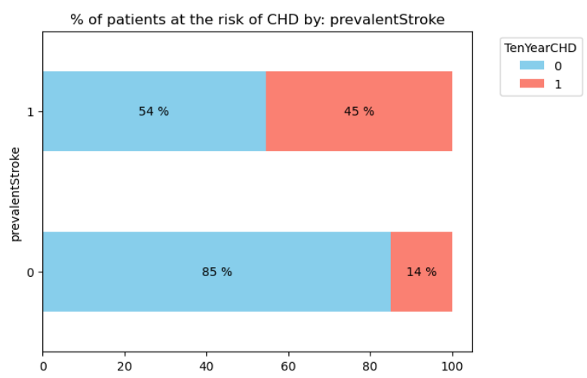
PrevalendHyp and PrevalentStroke:
Patients who have a history of hypertension and had a stroke previously have comparatively higher risk of CHD.

Slide 14
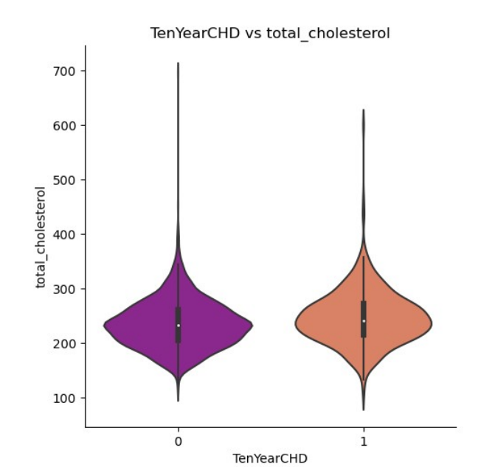
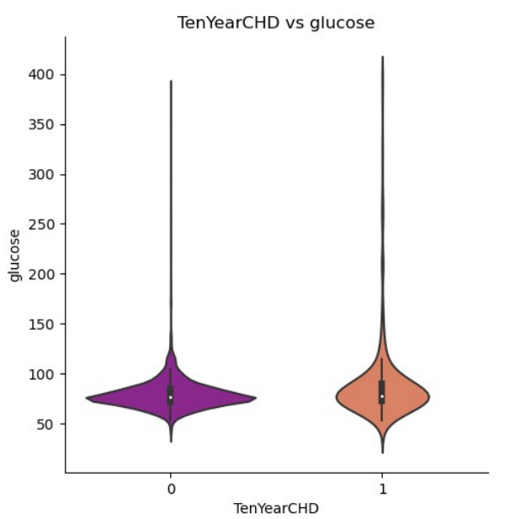
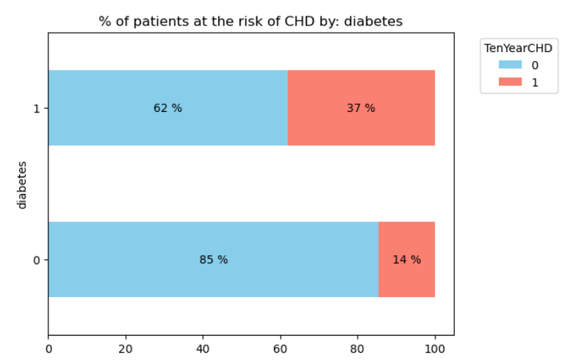
Relatioship between Total Cholesterol,Glucose and diabetes.
Similarly, patients with high cholesterol and glucose level (with diabetes) have higher risk of having CHD.

Slide 15
Other Observations:
Persons who are taking medications for BP are having Prevalent Hyp, that is the patient was hypertensive.
Bp_meds, prevalent_stroke, prevalent_hyp and diabetes are imbalanced, they have very few counts for the positive cases.
In education column 1(Higher Secorndary) Students has high tendency of having TenYearCHD when compared to all other columns of education.
There is low chances of CHD for non smokers compare to smoking persons
Low cigsPerDay comes with lower risk of CHD. Those who don't smoke, i.e., with a cigsPerDay of 0.0 has a really low risk of contracting the disease Although that is the case, low cigsPerDay doesn't actually guarantee a much lower risk of CHD
Finally for the positive prevalent stroke, the percentage is almost half indicating that the positive CHD is high for positive prevalent_stroke.

Slide 16
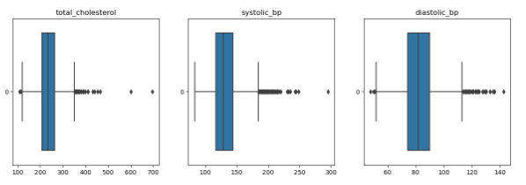
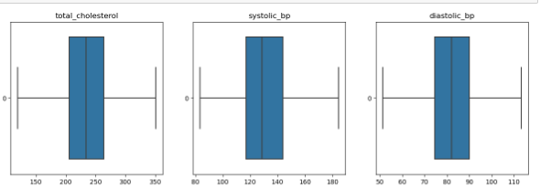
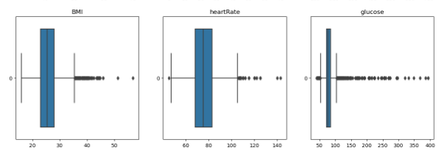
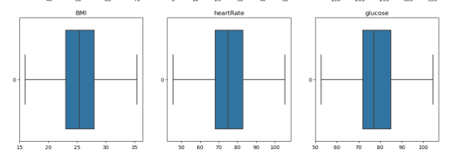
Handling Outliers: I had used “Interquartile Range" (IQR) method to handle outliers.
Box plot before handling Outliers
Box plot after handling Outliers

Slide 17
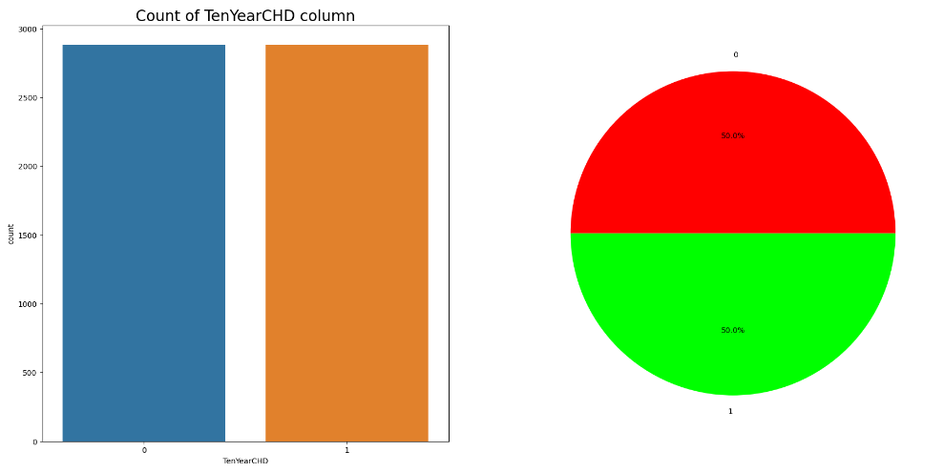
Handling Imbalance dataset
The resample function from scikit-learn's utils module is commonly used for resampling techniques in machine learning, particularly for handling imbalanced datasets.
This method is used to perform up-sampling of the minority class, ensuring that both classes in the dataset have an equal number of samples. This helps address class imbalance issues and improves the performance of machine learning models.(2879 for both class_0 and class_1)

Slide 18
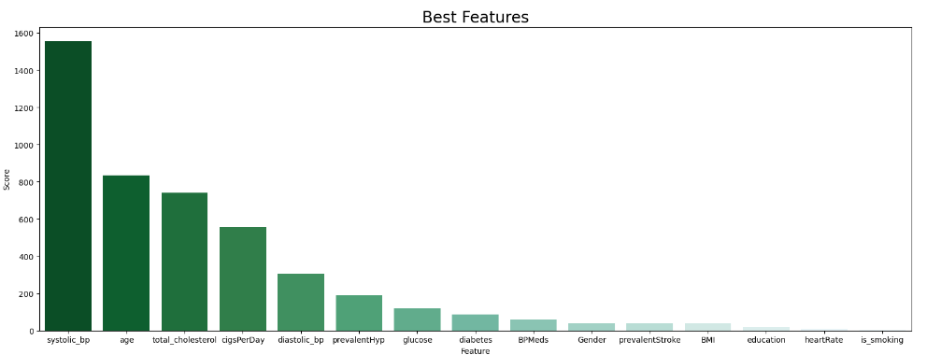
Feature Selection:
Using SelectKBest , for feature selection using the chi-squared (chi2) statistical test with a specified number of k best features to select.
“ SelectKBest” - This is a class in scikit-learn's feature selection module that selects the top k features based on a specified scoring function.
I had selected top 10 features according to this top scores.

Slide 19
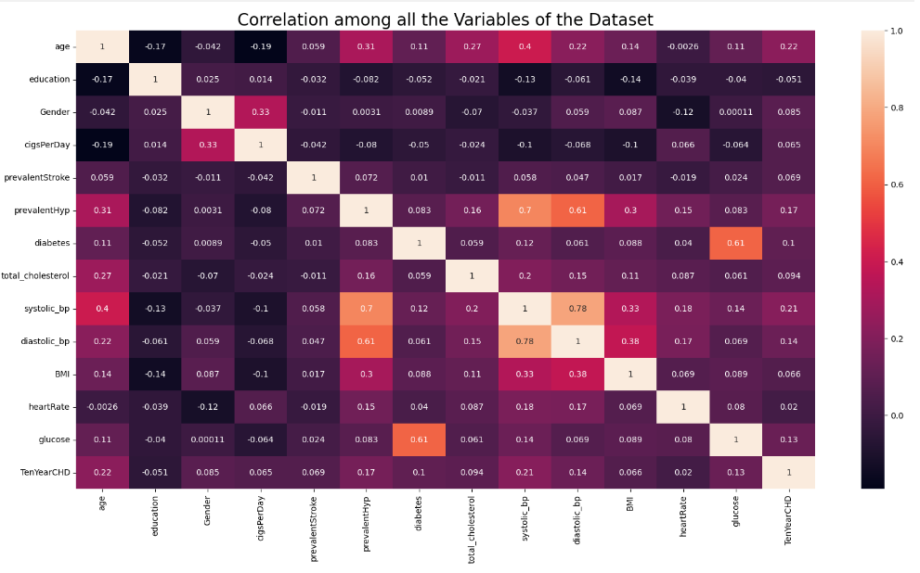
Heat map analysis using Correlation

Slide 20
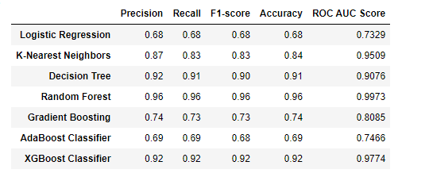
Model Training:
Created a multiple machine learning model like "Logistic Regression“,"K-Nearest Neighbors“, "Decision Tree“ , "Random Forest“ , "Gradient Boosting“ , "AdaBoost Classifier“ and "XGBoost Classifier“ to see which model is performing well.
Among all these Random forest,Decission tree and Xg_boost are performing well.

Slide 21
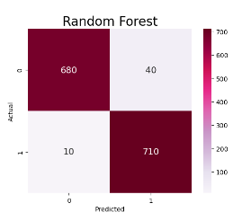
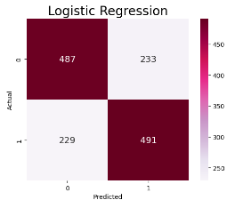
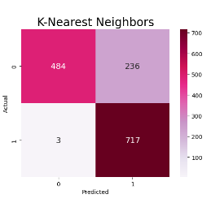
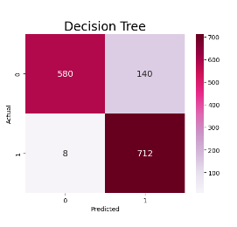
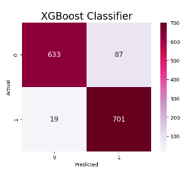
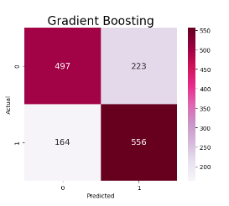
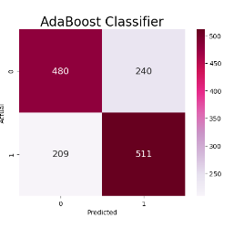
Confussion matrix for Test data:

Slide 22
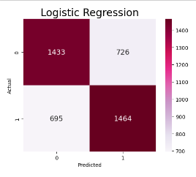
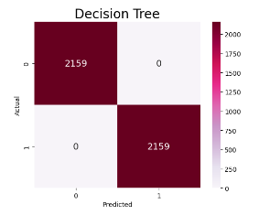
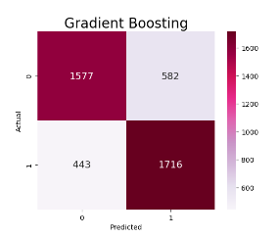
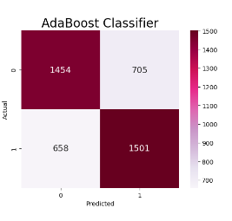
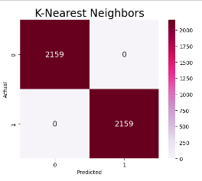
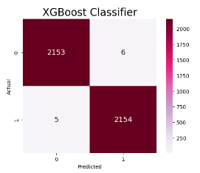
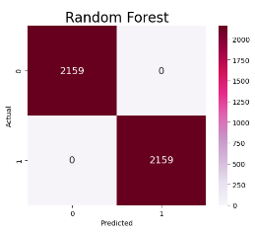
Confussion matrix for Train data:

Slide 23
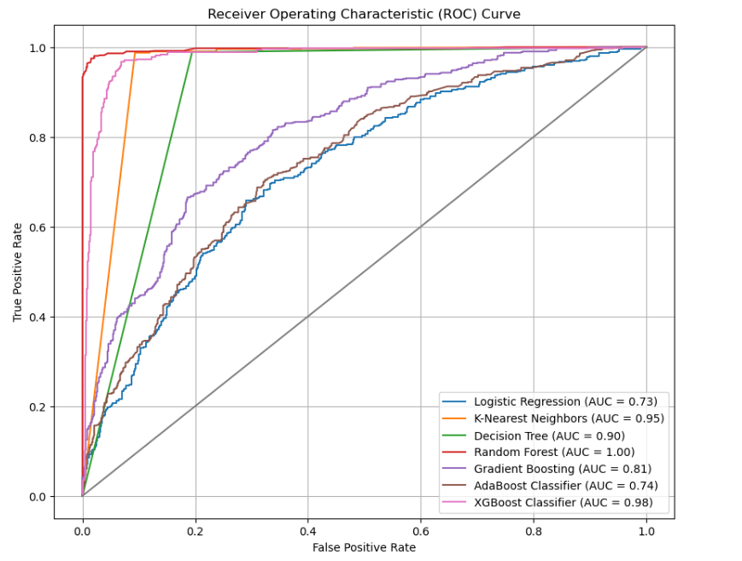
ROC CURVE:

Slide 24
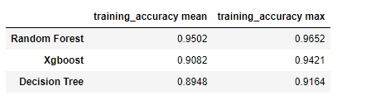
Cross-validation Method:
It looks the model is overfitting, So tried with cross-validation method for Random forest, XG-boost and Decision tree.
Not observed so much difference in mean and maximum accuracy across different folds or iterations of cross-validation
So we can conclude it is not a overfitting model

Slide 25
SUMMARY AND CONCLUSION:
When we compared our classification report with Train data, It looks like a overfitting model, But I had tried with cross validation method, Seems like a good performing model.
We can choose Random Forest model which is performing well with this dataset.
Tried with Different approaches like Smote, Basic Deep learning model, But this resampling method is Giving good results.
From my analysis, To summarize which variable is playing a main role whether the person will have a risk of having Coronory heart disease in next next 10 years are Aged peoples with higher systolic_bp,Higher cholesterol and smoking high number of cigarettes per day
diastolic blood pressureis the measures of pressure in our arteries when your heart rests between beats.
Also Aged peoples with Diabets, Prevalent stroke and Prevalent hypertension are mostly taking BP medications which will result in CHD.

Slide 26
THANK YOU

